Slide 1

ONLINE CLASSES
Pros and Cons
MADE BY:
BHANU PRATAP SINGH
9-E
http://www.free-powerpoint-templates-design.com

Slide 2
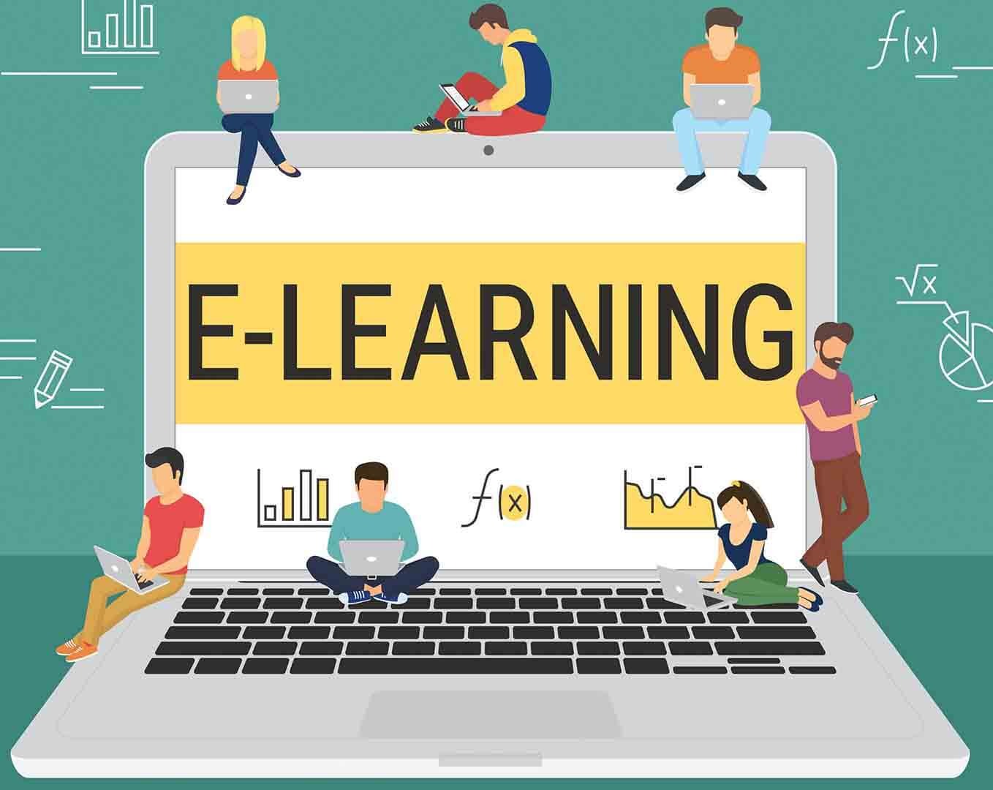
What is E-Learning
E- learning can encompass a wide variety of online initiatives. A good, broad way to think about e-learning is as the use of electronic devices (computers, tablets, or phones) to deliver educational or training content to learners.

Slide 3
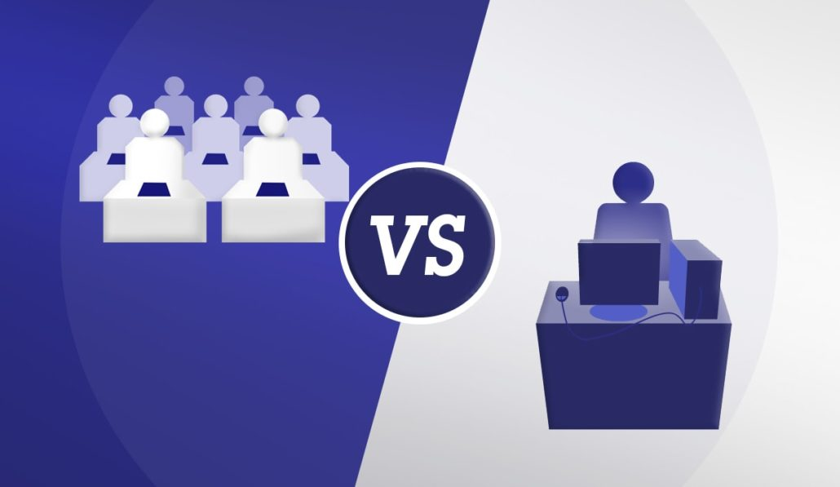
E-Learning vs. Classroom Learning
◆ E-learning Vs classroom learning is similar to cell phones Vs pay phones at the call cabins.  Cell phones allow you to communicate any time and usually anywhere, by having a properly configured phone.  E-Learning allows you to learn anywhere and usually at any time, by having a properly configured computer

Slide 4

Pros of Online Classes
It's less expensive to produce.
It’s self-directed and moves faster.
It can be updated easily and quickly .
It can lead to increased retention and a stronger grasp on the subject.
24/7 accessibility makes scheduling and managing easy for large groups of students.
It provides a consistent message
Enhances computer and Internet skills
Travel time and associated costs are reduced or eliminated
Inexpensive Worldwide Distribution
Cross-platform Support
It can work from any location and any time .
It's self-paced.

Slide 5
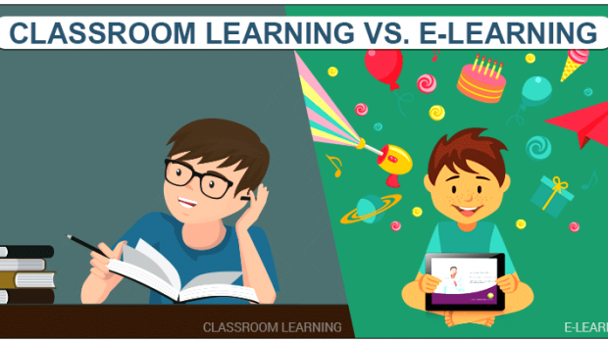
Cons of Online Classes
No self-discipline Proponents of e-learning claim that the main advantage of this learning method is that it is self-paced.
Lack of flexibility
Lack of input from trainers E-learning is structured.
Slow evolution After an e-learning course is developed, it can take an inordinately long time for any needed changes to be worked in.
Too much time spent in front of a computer screen may be harmful.
No matter how hard we try to fully transfer human communication to online platforms, no matter how natural it seems to form relationships behind computer screens, a virtual environment is just not human. Nothing can replace human contact.

Slide 6

THANK YOU

